Slide 1
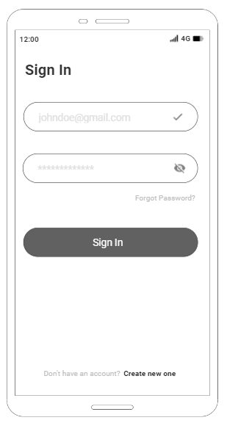
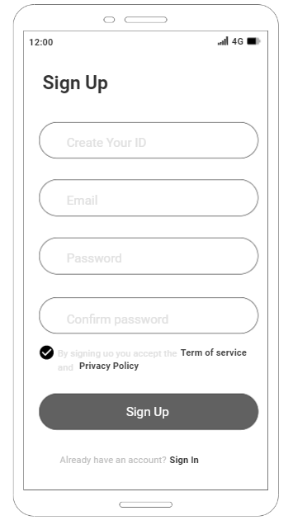
Sign In / Sign Up Layout
This Application Name: RenewIt
Token Name : RenewToken
Symbol : REN
First time your open this apps after finished installation you moved to Sign In Layout
If you don’t have an account you must tap “Create new one” then you fill the inquries to sign up
After you Sign In there will be pop up notification and give you an option to choose, “Did you want get our designable garbage bin or not?” Tap “Yes” or “No”
If you tap Yes our team will send you a garbage bin 1-2 office day

Slide 2
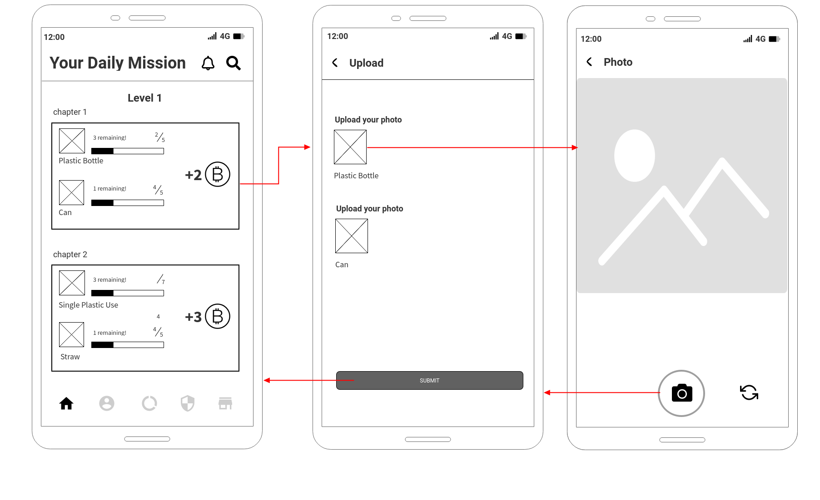
First Bottom Navigation
To get the token from this apps, you must be completed the daily mission.
First, You tap daily mission which included the type of trash that given to you
Second, Tap a particularly trash such as plastic bottle or straw
Third, you must put the trash in our garabage bins, and the trash must be suit to what kind of trash given to you form the apss
If you don’t take phot of the trash in our garbage you cant upload it. Our garbage bin is term of this condition, to complete your task

Slide 3
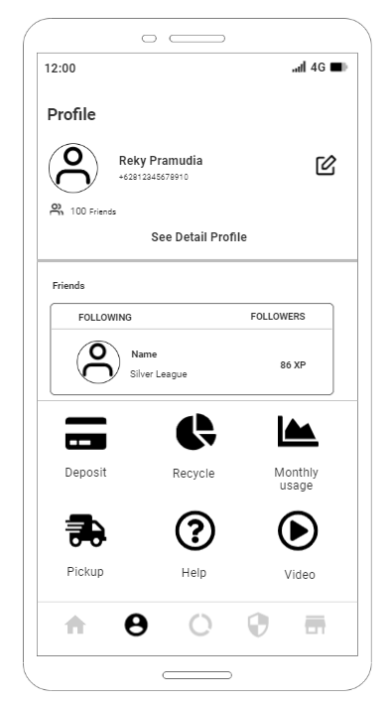
Second Bottom Navigation
Profile included name, phone your friends and u can edit it later
Compete with your friends
Deposit: You can deposit your rupiah via bank transfer. And your balance info show in this feature
Recycle: Data of total amount of trash until now, fot instance Plastik Bottle: 100pcs, straw: 50pcs, cardboard: 70pcs
Monthly usage: Visualization data of your total token that use to convert into solar panel energy or VA per month
Pickup: you will get notification form our team, if our team wanted to pick up your trash. This feature is only active if you choose “Yes” you want our designable garbage
Help: Included FAQ, Customer Service and etc
Video: our team peomotion, our program, our recycling activity CSR program ang many others activity

Slide 4
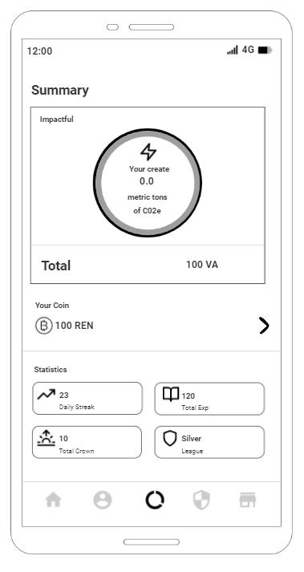
Third Bottom Navigation
what your carbon footprint looks like based on your home’s electricity usage. reducing your carbon impact, and increasing the demand for more renewable energy on the grid.
Total VA that you used from to electricity usage
You can redeem our token if you have enough balance
Total Exp: you get this XP after you complete daily mission, this XP important to determine your position in League to reach and climbing to higher league. And you will earn extra reward too
Daily Streak: you never skip your daily mission,
Crown: every complete 5 daily mission you will get crown
League: Represent your current league position

Slide 5
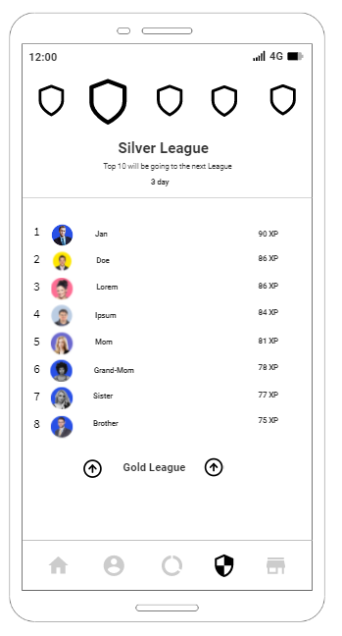
Fourth Bottom Navigation
Represent your current league,
3 day left to gain your XP and the day will end of the season of the league,
Top 10 in every League will get some extra coin & going to the next league, the higher your league the more coin you will get
Your XP get from complete the daily mission
Because you in Top 10 in Silver League, you must be to Gold League in the next season

Slide 6
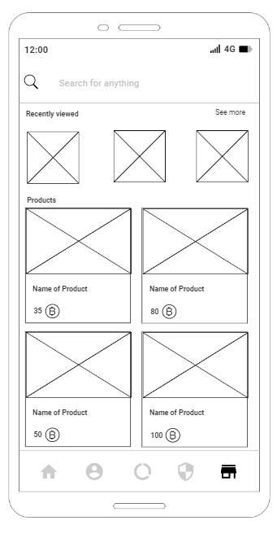
Fifth Bottom Navigation
You can search item or products
List of products available in this apps, you can buy products use REN Token
The products list in this apps related to our mission to reduce and give sustainability impact to our environment for instance: Tumblr, Stainless straw, Totebag, paper straw, reusable cotton, fork spoon portable set, etc

Slide 7
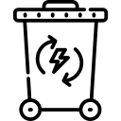
Our Garbage bin illustration
You can only put the trash in our garbage bin that already set in apps, Photo your trash in our garbage bin

Slide 8
Thank You

